Slide 1
Intro to R: Mini Project
December 2020

Slide 2

Introductions!
Please share your name and a little about your current position/role!
What are you hoping to accomplish with R in the short term? Long term?

Slide 3
What makes a “good” project?

Slide 4
Picking a project
Keep it small! Smaller than you think.
Ideally, your program should perform one task
Think of some task you do regularly
Would it be accomplished faster if automated?
Would you get fewer errors?
Will there be less effort for you?

Slide 5
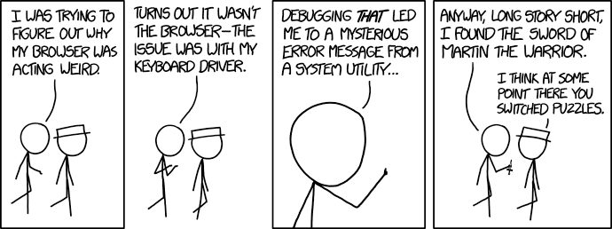
Getting Stuck and What To Do About It
https://xkcd.com/1722/

Slide 6
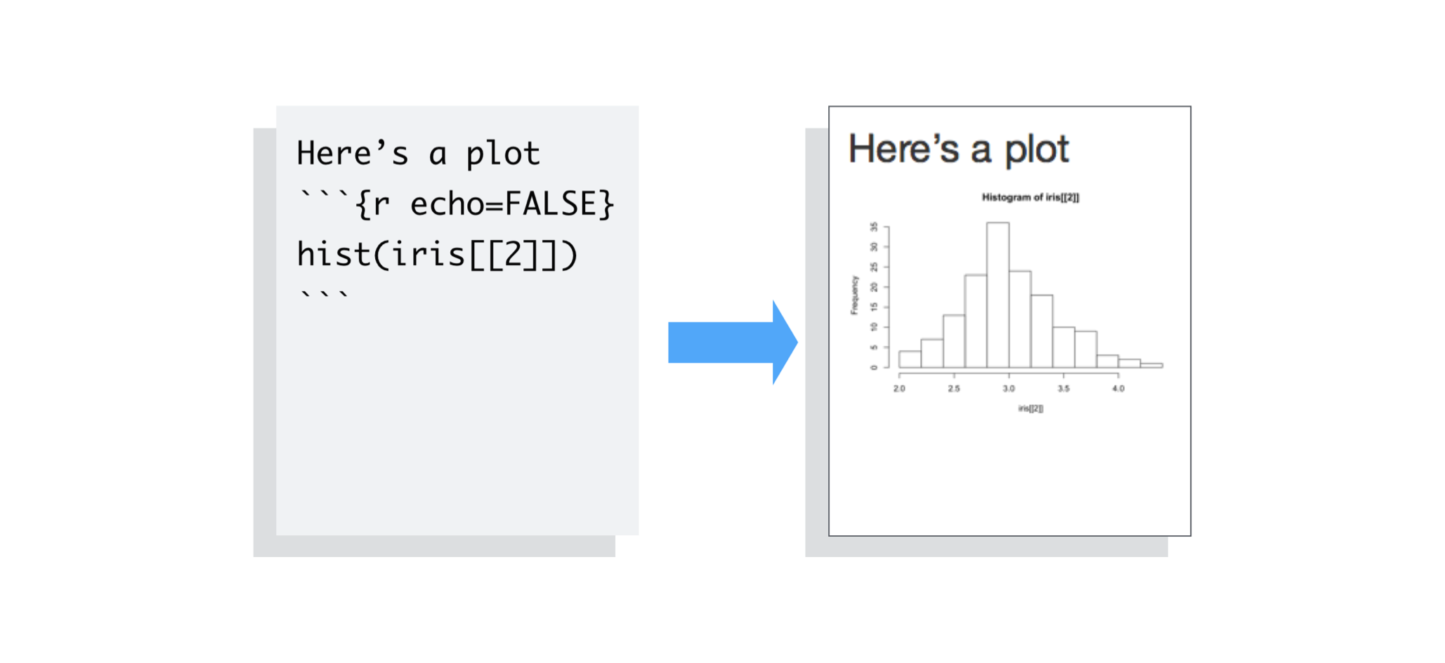
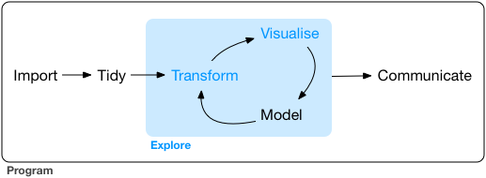

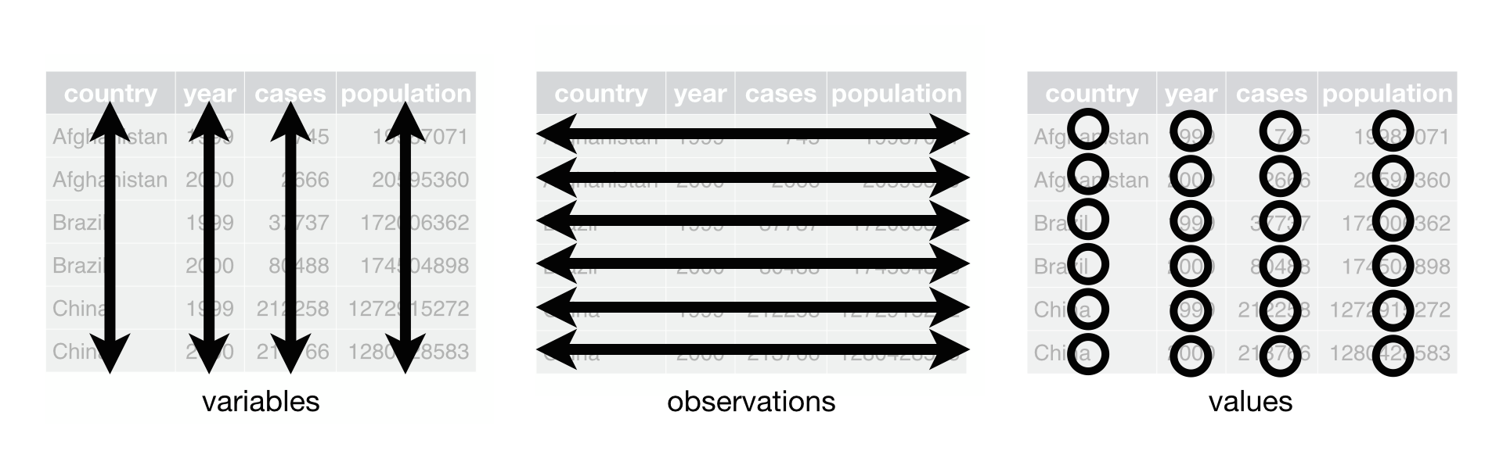
R mental models
https://rpubs.com/collnell/ggplot2
https://rmarkdown.rstudio.com/articles_intro.html
https://r4ds.had.co.nz/

Slide 7
Mental modeling of getting unstuck

Slide 8
Tools for unsticking
We’re here to help you if you get really stuck, but there are places to look first:
Google!
Stack Overflow-- chances are if you have a question, someone else has asked it before
The CHOP R User Group Slack
Discourse

Slide 9
Resources

Slide 10
Useful tools
R for Data Science, by Hadley Wickham & Garrett Grolemund (https://r4ds.had.co.nz/)
RStudio cheatsheets: https://rstudio.com/resources/cheatsheets/
RStudio primers: https://rstudio.cloud/learn/primers
The Arcus Education website: https://education.arcus.chop.edu/

Slide 11
Useful tools
R bootcamp (interactive lessons): https://r-bootcamp.netlify.app/chapter1
For more resources, revisit the course website: https://skadauke.github.io/intro-to-r-for-clinicians-chop/
If you find more resources that you like, be sure to share!

Slide 12
Presenting Your Hard Work!

Slide 13
Presentations
We ask that everyone give a brief presentation at a future CHOP R User Group meeting (date TBD, estimated ~3 months from now)
Talk about your topic and how you used R to complete the task
A helpful R Markdown template to get started: https://github.com/skadauke/intro-to-r-for-clinicians-chop/blob/master/exercises/r_project_template.md

Slide 14
Questions?

